Slide 1
Introduction to R
Lecture 1c

Slide 2
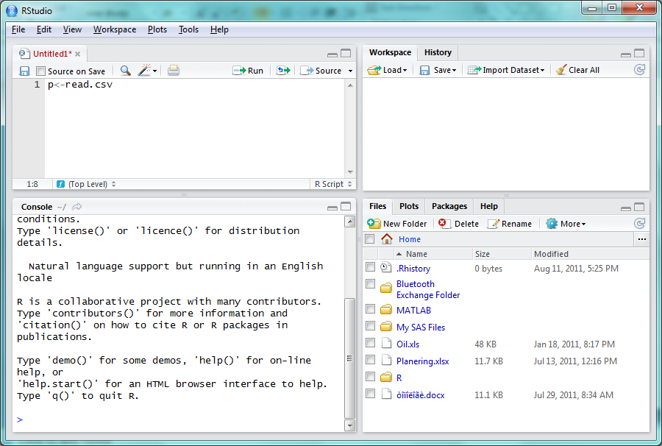
R
R is a programming language of a higher-level
Constantly increasing amount of packages (new research)
Free of charge
Website: http://www.r-project.org/
Code Editor: http://rstudio.org/

Slide 3
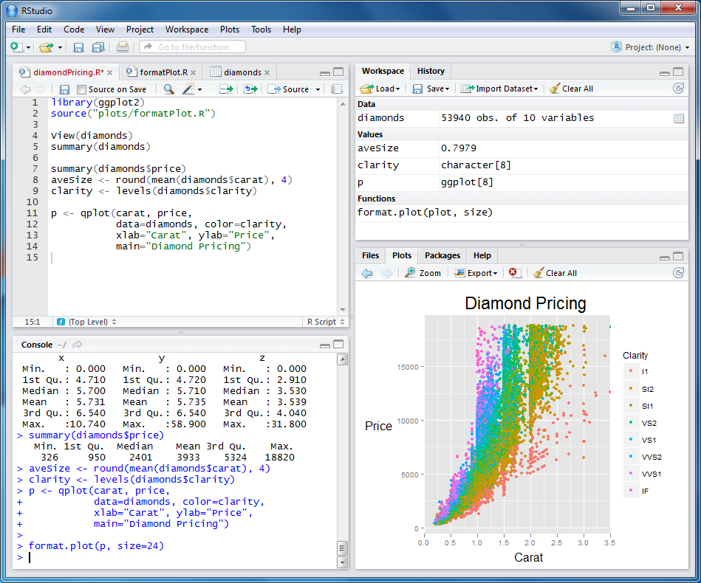
Software: use RStudio
Install R: http://www.r-project.org/
Install RStudio: http://rstudio.org/
Program
Workspace
Plots
Execution console

Slide 4
Basics in RStudio
Important to know:
Create a new file and save it (File menu)
Running one line or entire code (Edit menu)
Running one line in console
Workspace (Observe, Save, Clear)
Setting current directory (Tools)
Installing new package (Packages tabs)

Slide 5
Call help
Specific function
help(function)
Help browser
help.start()
Search for something in help
help.search(“expression”)
Quick reminder of function arguments:
args(function)
Examples of how to use function:
example(function)
If some method is not installed on the computer:
RSiteSearch(”expression")

Slide 6
Introduction
R is case-sensitive (A and a)
Each command on a new line
Comment:
#R is a very cool language!
Initialize/set the variable
Use-> or <- or =
a<-3
a=3
3->b

Slide 7


Vectors
Create a vector
x<-c(1,3)
See the result
x
print(x)
Create an empty vector
Y=numeric(10)
Y

Slide 8
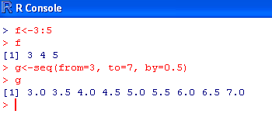
Sequence
Either‘: ‘ or seq()

Slide 9
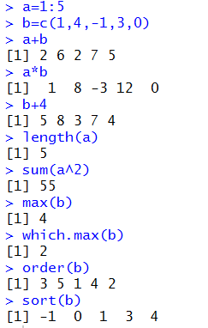
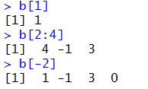
Operation with vectors
indexing
Element-wise: +-*/^
log exp sin cos
length –number of elements
sum - sum of all elements
max min sort order
which.min which.max
Logicals:
TRUE or FALSE:
A=TRUE;
== > >= < <= != & (and) | (or)

Slide 10
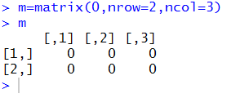
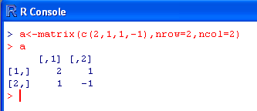
Matrices
Use matrix()
a<-matrix(values,nrow=m,ncol=n)
Values should be listed columnvise
nrow= and ncol= can be skipped
Create empty matrix

Slide 11
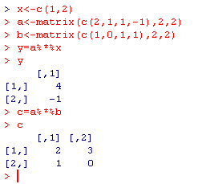
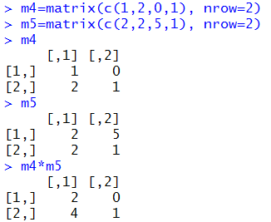
Matrix operations
Usual vector operations can also be applied:

Slide 12
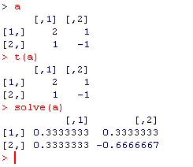
Matrix operations
Matrix operators/functions:
transpose b=t(a)
b = a^{T}
Inverse b = a⁻¹
b=solve(a)
Solve d=a⁻¹b
d=solve(a,b)

Slide 13

Indexing for matrices
Positive index
x[1,6] x[2:10,]
Negative index
x[2,-(1:5)] row 2 and all columns except 1:5
Entire column or row
y=x[2,] entire row 2
Extraction
x[x>5]

Slide 14
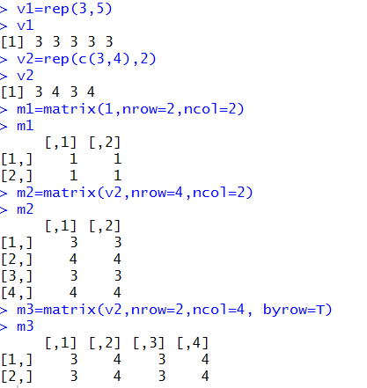
Replication
Replication for vectors
rep(what, times)
Replication for matrices
matrix()

Slide 15
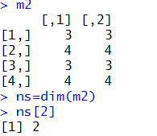
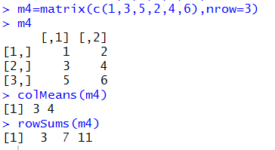

Matrix operations
Dimension
dim(mat)
Row/column stististics
colMeans, rowMeans, colSums,rowSums
Apply a function over vector/matrix
Sapply()
Normally used when function works only element-wise

Slide 16
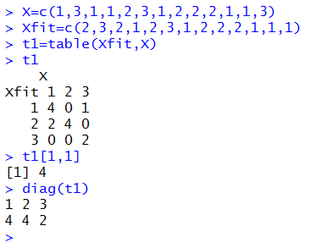
Vector/matrix operations
Create confusion matrix (classification)
table(X,Y)
Extract diagonal
Diag(X)

Slide 17
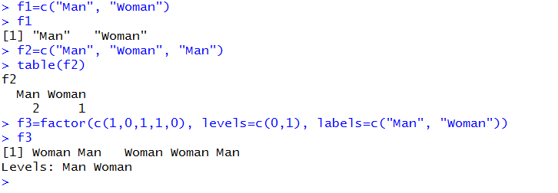
Factors
Text values

Slide 18
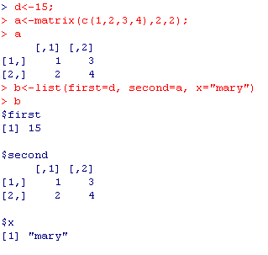

Lists
List is a collection of objects

Slide 19
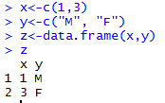
Data frame
Vectors and matrices of the row length can be collected into a data frame
Used to store the data of different types into a single table
Use data.frame(object 1, object 2, … , object k)

Slide 20
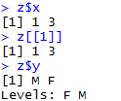
Data frame
Any column in the data frame can be retrieved by
dataframe$object
Any row in the data frame can be extracted by using matrix notation, for ex: z[1,]

Slide 21
Read data from Excel file
Save as ”comma-separated file”(csv)
Change current directory, Session→ Set Working Directory or setwd()
Use
Dataframe=read.csv2(file_name)
Dataframe=read.csv(file_name)

Slide 22
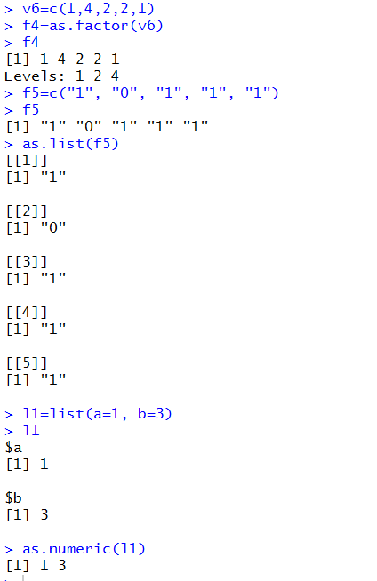
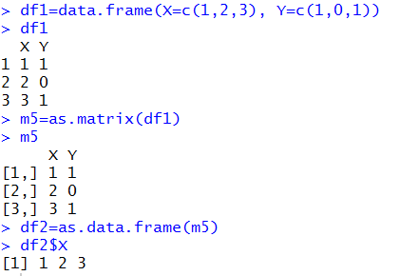
Conversion between types
Data frame to matrix
Matrix to data frame
Numeric to factor
Factor to numeric
List to vector
Vector to list

Slide 23
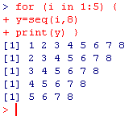
Loops
for (name in expr1 )
{
…
}
while (condition)
{
…
}

Slide 24
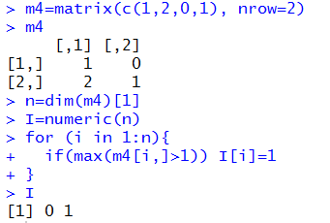
Conditioning and loops
If (x==3) {
…
…
} else {
…
}
for (i in 2:99) {
…
}
while(x!=29) {
…
}

Slide 25
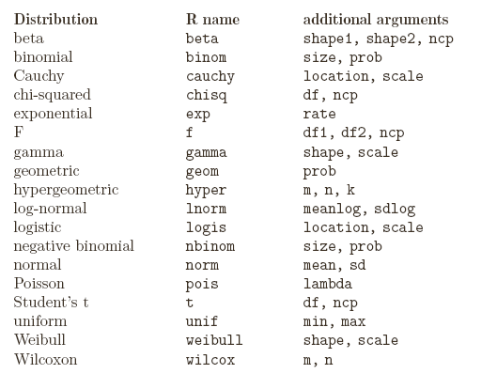
Random number generation
Random are not random
Use set.seed(12345) to get identical results
A plenty of random number generators
Rnorm
Runif
…
Use d for density p for CDF q for quantiles and r for simulation:
(ex: rnorm pnorm dnorm qnorm)

Slide 26
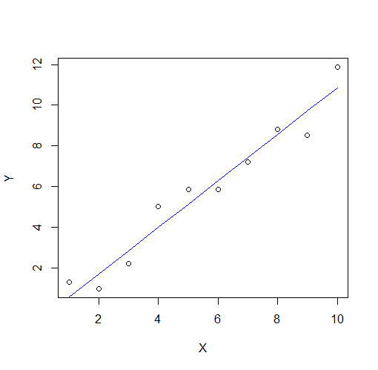
Using a function
Use ?name_of_function to see function parameters
For ex. ?lm
There are some obligatory parameters and optional parameters
The optional parameters can be specified in different order
X=1:10
Y=1:10+rnorm(10)
W=c(rep(1,5), rep(2,5))
mydata=data.frame(X,Y)
result=lm(Y~X, weights=W,data=mydata)
?predict.lm
Fit=predict(result)
plot(X,Y)
points(X,Fit, type="l", col="blue")

Slide 27
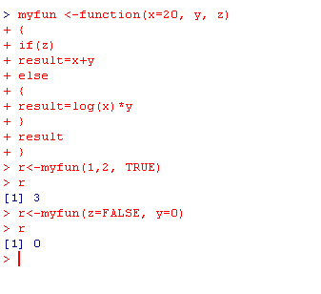
Writing your own functions
Function writing must always end with writing the value which should be returned!
You may also use ”return(value)” to show what value the function should return

Slide 28
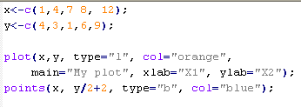
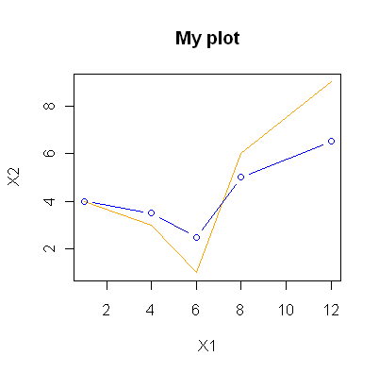
Graphical procedures
Some common procedures:
plot(x,..) plots time series
plot(x,y) scatter plot
plot(x,y) followed by points(x,y) plots several scatterplots in one coordinate system
hist(x,..) plots a hitogram
persp(x,y,z,…) creates surface plots
cloud(formula,data..) creates 3D scatter plot

Slide 29
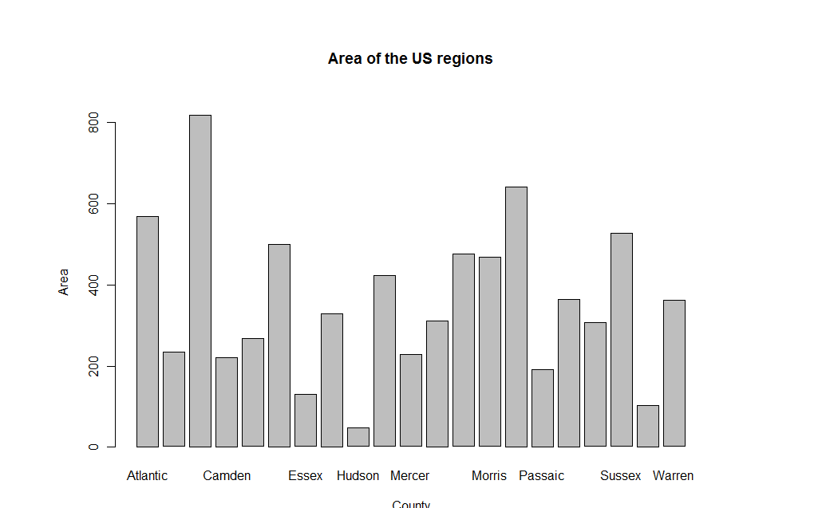
Graphical parameters
Adjust color of a graphical object by specifying
col=
Other typical parameters for graphical functions
main=”text” Title”text”
sub=”text” Footnote ”text”
xlab=”text” X-axis label
ylab=”text” Y-axis label
mydata<-read.csv2("Counties.csv");
barplot(mydata$Area, names.arg=mydata$County, main=”Area of the US regions”, xlab=”County”, ylab=”Area”);

Slide 30
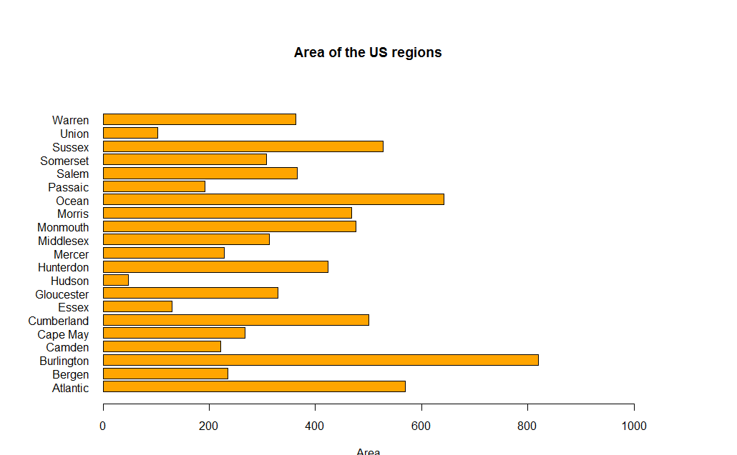
Graphical parametes
Some parameters need to be specified either in the plotting function or inside par(…)
Pch=number – symbol that is plotted
Lty=number – linetype
Las=0 1 eller 2 Direction of axis values
mai=c(bottom, left, top, right) – margins (inch)
adj=between 0 and 1, horizontal justification
barplot(mydata$Area, names.arg=mydata$County, horiz=TRUE, las=1, xlim=c(0,1000), col="orange", main="Area of the US regions", xlab="Area");

Slide 31
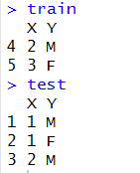

Some more examples
Dividing training/test
Computing misclassification rate
data=data.frame(X=c(1,1,2,2,3), Y=c("M","F","M","M","F"))
n=dim(data)[1]
set.seed(12345)
id=sample(1:n, floor(n*0.5))
train=data[id,]
test=data[-id,]
missclass=function(X,X1){
n=length(X)
return(1-sum(diag(table(X,X1)))/n)
}

Slide 32
More about R
Important: read manuals of dplyr and tidyr packages (data manipulation)
R language manual https://cran.r-project.org/doc/manuals/r-release/R-intro.pdf

